Slide 1
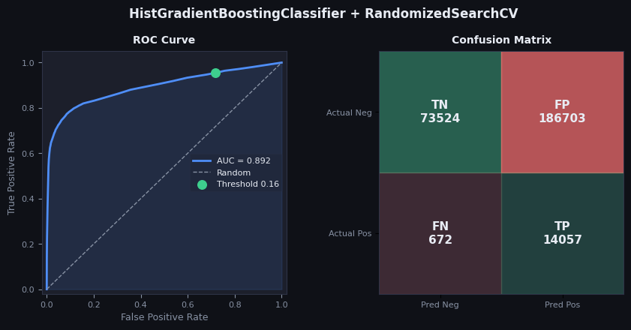
HistGradientBoostingClassifier
Notes:
My approach was to take use a randomised search to tune a HistGradientBoostingClassifier model. scikit-learn’s documentation suggests that, for datasets over ten thousand rows, a histrogram-based approach is computationally more efficient than for GradientBoostingClassifier. I trained on a StratifedKFold to use the entire dataset, but after hyperparameter tuning I refitted the best parameters using an out-of-fit cross-validation to prevent data-leakage but permit the whole dataset to be used. My AUC score was lowest of our group at 0.892, but still not far out.
Given the misleading nature of accuracy, I decided to focus solely on recall. I wrote a function to determine a desired threshold value based upon an intended recall target, here choosing 95%. This provided a more aggressive threshold of 0.162, which weights a false positive just over five times stronger than a false negative. This leads to an odd-looking confusion matrix with a very large number of false positives, but in the context of Covid screening I decided to absolutely prioritise this over accuracy and precision

Slide 2
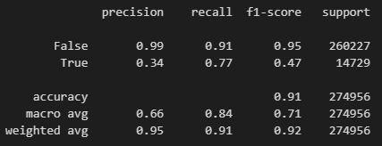
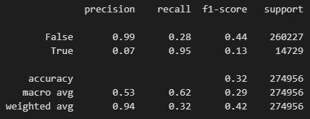
HistGBC Classification Report
Standard Threshold = 0.5
Threshold = 0.162
Notes:
This is the consequential impact on the respective classification reports. Even with a standard threshold precision in the true class is low, but is reduced further when prioritising recall. An alternative method could be to prioritise a f-beta score, for some beta greater than 1, to give some weight to retaining a level of precision.
It should be noted that any choice of threshold isn’t a strictly analytical problem, and indeed requires stakeholder input. While in this case we can assume that this screening is cost-neutral for prediction/outcome pair, tuning the threshold depends on balancing the consequences of lower precision and recall scores. Choosing any arbitrary threshold thus doesn’t doesn’t change the ROC curve or the area under the curve, only at what probability level True is assigned.
HistGBC, as with many tree models in unsupervised learning, does have a habit of trying to push confident predictions towards extreme values. I therefore experimented with CalibratedClassifierCV, which aims to calibrate the probabilities back to something more meaningful to a stakeholder.

Slide 3
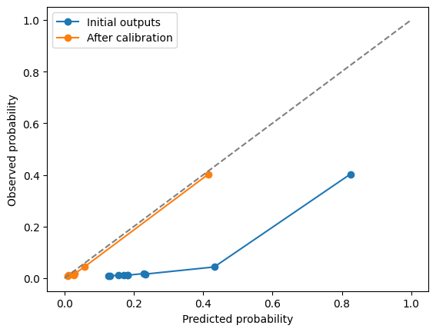
Calibrated HistGBC Model
Notes:
Given the previously generated out-of-fold probabilities of the True class by the model, this chart demonstrates that the model is generally over-predicting the instances of true cases. An example is how frequently the model assigns probabilities in the range 0.4-0.8 to the True class, when the observed positive rates in that rate are closer to the range of 0.05-0.4.
This converts the probabilities into something more interpretable to the stakeholder, so that a predicted model probability of 0.25 now means that “approximately 1 in 4 cases that have similar characteristics returned a positive test”. This calibration acts independently of the model performance via area under curve score.

